Slide 1
Theory of Automata and Formal languages
CS3434
Lecture 01

Slide 2
Text and Reference Material
Introduction to Computer Theory, by Daniel I. Cohen, John Wiley and Sons, Inc., 1991, Second Edition
Introduction to Languages and Theory of Computation, by J. C. Martin, McGraw Hill Book Co., 1997, Second Edition
Theory Of Automata

Slide 3
Grading
Following is the division of marks:
Mid-Term Exam 25
Assignments 10
Quizzes 15
Final Exams. 50
  Marks division might change during the semester

Slide 4
INTRODUCTION

Slide 5
Introduction
Psychologists, mathematicians, engineers and some of the first computer scientists shared a common interest:
  To model the human thought process.
  Whether in the brain or in a computer.
Warren McCulloch and Walter Pitts, two neurophysiologists, were the first to present a description of finite automata in 1943.

Slide 6
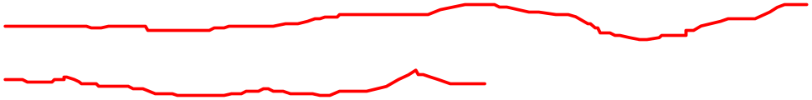
What this Course Covers?
Theory of Automata is a fundamental course in computer science that deals with the study of abstract computing devices, called automata, and the languages they recognize. It provides a theoretical foundation for understanding how computing works, and how it can be analyzed.
The course covers various models of computation, including finite state machines, pushdown automata, and Turing machines. By studying these models, you will gain a deeper understanding of the capabilities and limitations of computing machines, and how they can be used to solve different types of problems.
Courtesy Costas Busch - RPI

Slide 7
Theory of Automata has important practical applications in various areas of computer science, such as compilers, software engineering, artificial intelligence, and cryptography. It is also useful for understanding the limits of what can be computed, and for designing efficient algorithms for solving complex problems.
Finally, studying Theory of Automata is essential for anyone pursuing a career in computer science or related fields, as it provides a solid foundation for understanding the fundamental concepts and principles that underlie all of computer science.
Courtesy Costas Busch - RPI

Slide 8
Objective of the Course
This course is about the fundamental capabilities and limitations of computers.
This theory is very much relevant to practice, for example, in the design of new programming languages, compilers, string searching, etc., etc.
This course helps you to learn problem solving skills.
Theory teaches you how to think, express and solve problems,.

Slide 9
Cont….
Every time we introduce a new machine, we will learn its language; and every time we develop a new language, we will try to find a machine that corresponds to it.
In particular, the way we shall be studying about computers is to build mathematical models, called machines, and then to study their limitations by analyzing the types of inputs on which they can operate successfully.
The collection of these successful inputs is called the language of the machine

Slide 10
Automata Theory
Automata theory is the study of:
  Abstract machines (or more appropriately, abstract 'mathematical' machines or systems)
  And the computational problems that can be solved using these machines.
These abstract machines are called automata.
Automata is a word formulated from automation, which means machine designing or replacing human beings with machines
It is the plural of automaton, and it means “something that works automatically”.
An automaton can be a finite representation of a formal language that may be an infinite set.

Slide 11
Mathematical Preliminaries

Slide 12
SETS
Definition: A set is well defined collection of objects, which are
  unordered
  distinct
  same type
  with common properties
Sets are written with curly braces {}, and the elements in the set are written within the curly braces.
The set {a, b, c} has elements a, b, and c.
The sets {a, b, c} and {b, c, b, a, a} are the same since order does not matter in a set and since redundancy does not count.
The set {a} has element ‘a’. Note that {a} and a are different things; {a} is a set with one element a.

Slide 13
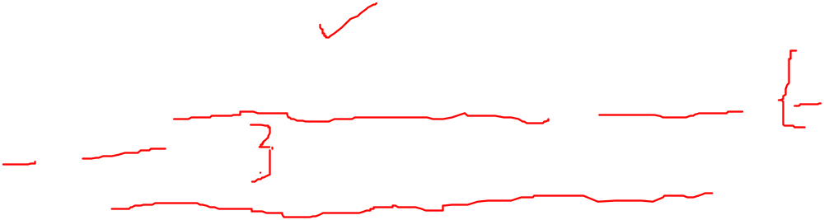
The set {xn : n = 1, 2, 3, . . .} consists of x, xx, xxx, . . ..
The set of positive even numbers is {2, 4, 6, 8, 10, 12, . . .} = {2n : n =1, 2, 3, . . .}.
The set of odd numbers is {1, 3, 5, 7, 9, 11, 13, . . .} = {2n + 1 : n = 0, 1, 2, . . .}.

Slide 14
Set Representations
  C = { a, b, c, d, e, f, g, h, i, j, k }
  C = { a, b, …, k }
  S = { 2, 4, 6, … }
  S = { j : j > 0, and j = 2k for some k>0 }
  S = { j : j is nonnegative and even }
finite set
infinite set
Courtesy Costas Busch - RPI

Slide 15
  S = { j : j > 0, and j = 2k for some k>0 }
"S is the set of all j such that j is a positive even integer."
S = { j : j is nonnegative and even }
"S is the set of all j such that j is a nonnegative even integer.“
Courtesy Costas Busch - RPI

Slide 16
  "S is the set of all j such that j is a positive odd integer.“
  S = {j : j > 0, and j = 2k + 1 for some integer k}
  The first condition, j > 0, ensures that the set only includes positive integers. The second condition,
  j = 2k + 1 for some integer k, defines the odd integers as those that can be written in the form of 2k + 1, where k is any integer. The colon (:) separates the description of the element j from the conditions it must satisfy, and the braces {} enclose the entire set.
Courtesy Costas Busch - RPI

Slide 17
A = { 1, 2, 3, 4, 5 }
U
6
A
2
8
1
3
7
4
5
9
10
Universal Set: all possible elements
    U = { 1 , … , 10 }

Slide 18
Set Operations
A = { 1, 2, 3 } B = { 2, 3, 4, 5}
Union
A U B = { 1, 2, 3, 4, 5 }
Intersection
    A B = { 2, 3 }
Difference
    A - B = { 1 }
    B - A = { 4, 5 }
A
B
2
4
1
3
5
U
2
3
1
Venn diagrams
Courtesy Costas Busch - RPI

Slide 19
Complement
      Universal set = {1, …, 7}
      A = { 1, 2, 3 } A = { 4, 5, 6, 7}
4
A
A
6
1
3
2
5
7
A = A

Slide 20
{ even integers } = { odd integers }
Integers
1
odd
0
5
even
2
6
4
3
7

Slide 21
DeMorgan’s Laws
A U B = A B
U
A B = A U B
U

Slide 22
Empty, Null Set:
= { }
S U = S
S =
S - = S
- S =
U
= Universal Set

Slide 23
Subset
A = { 1, 2, 3} B = { 1, 2, 3, 4, 5 }
U
A B
Proper Subset:
U
A B
B
A

Slide 24
Disjoint Sets
A = { 1, 2, 3 } B = { 5, 6}
A B =
U
A
B

Slide 25
Set Cardinality
For finite sets
A = { 2, 5, 7 }
|A| = 3
(set size)

Slide 26
Powersets
A powerset is a set of sets
S = { a, b, c }
Powerset of S = the set of all the subsets of S
2^{S} = { , {a}, {b}, {c}, {a, b}, {a, c}, {b, c}, {a, b, c} }
Observation: | 2^{S} | = 2^{|S|} ( 8 = 2³ )

Slide 27
Cartesian Product
A = { 2, 4 } B = { 2, 3, 5 }
A X B = { (2, 2), (2, 3), (2, 5), ( 4, 2), (4, 3), (4, 5) }
|A X B| = |A| |B|
Generalizes to more than two sets
A X B X … X Z

